Slide 1
Directed Panspermia Architecture: Mission Dynamics, Interception Physics, and Multi-Layer Bio-Shielding for Interstellar Objects
A Technical Study and Mission Analysis Synthesis
Dr Dragan Lukić
Institute of Physics, Zemun

Slide 2
To the reader.
All ilustrations in this presentation are formed by AI and do not have any similarity with existing space programs.

Slide 3
Outline
What We Want?
Why embeding in ISO vs sending rockets?
Hypervelocity mitigation
Mission launch and Oberth maneuver
Additional Biological Protection
Economic Optimization for Spaceflight

Slide 4
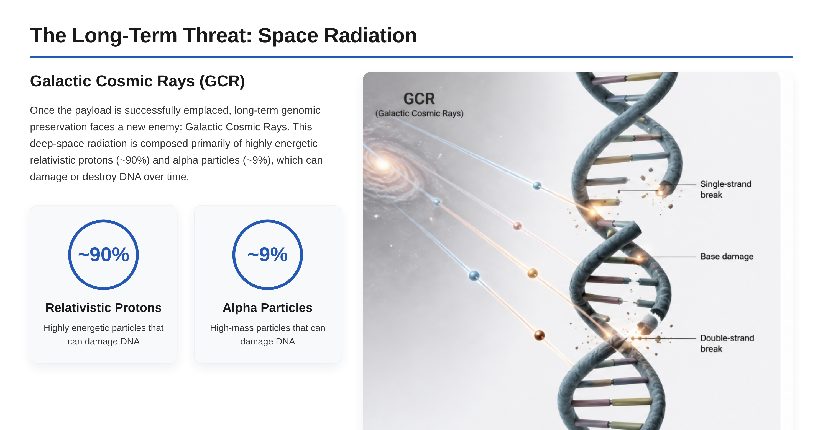

Slide 5
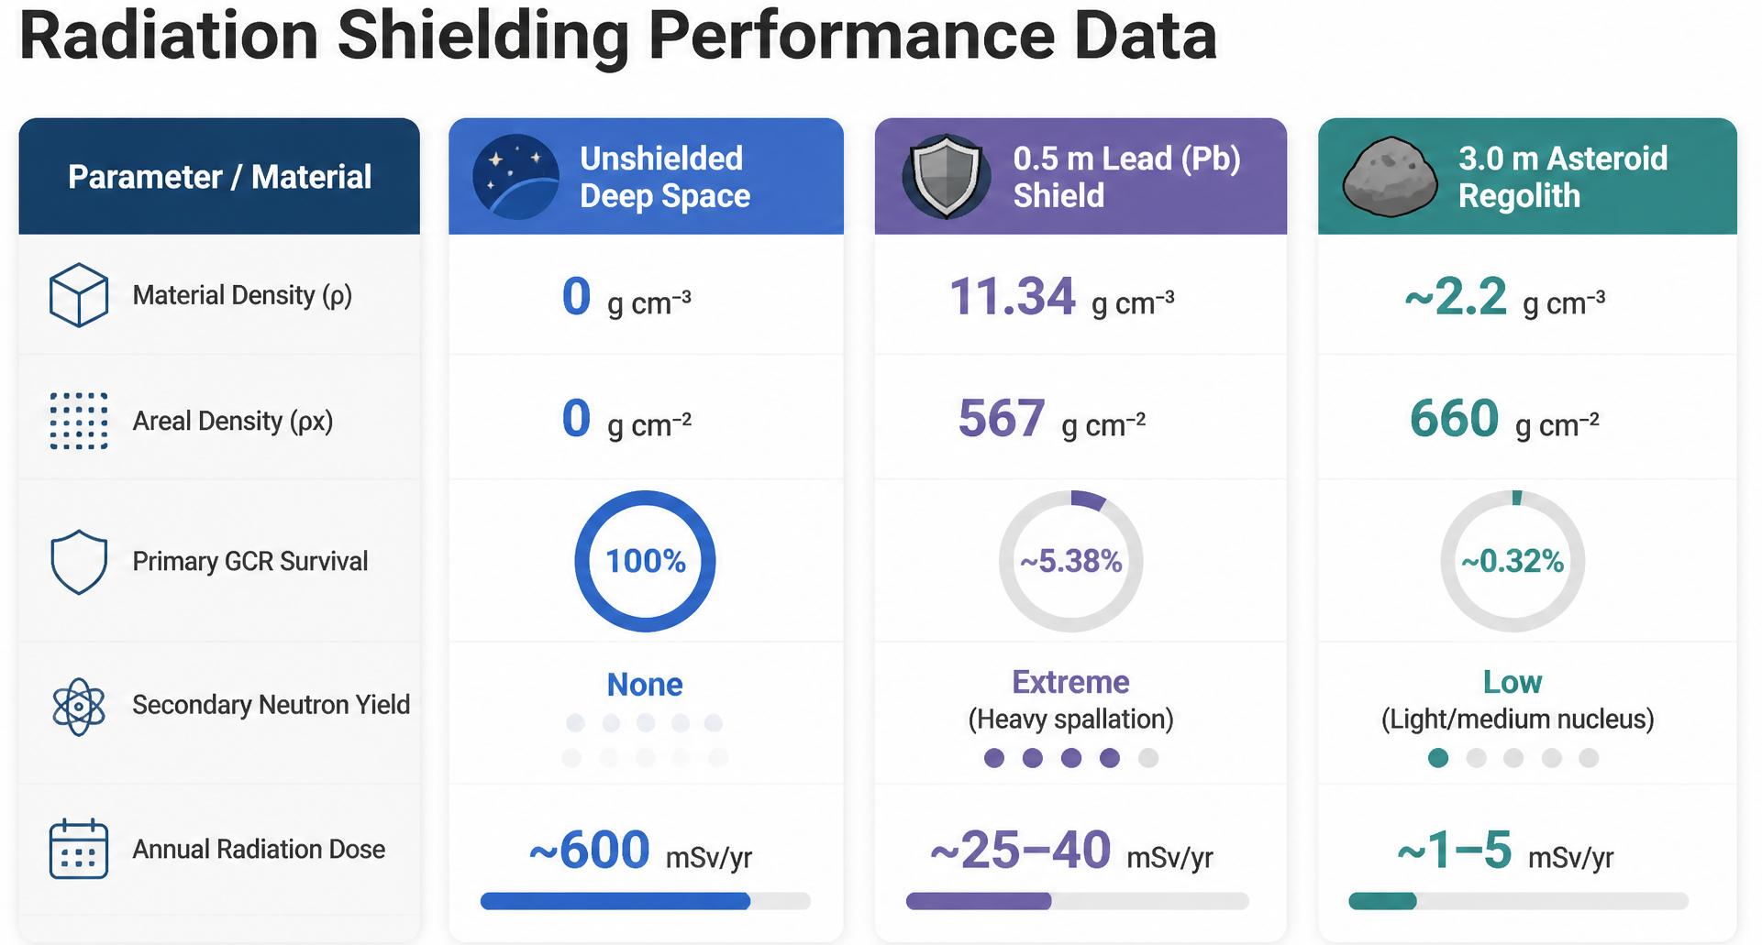

Slide 6
If we invent new source of energy light enough we can sent our probe with life samples by rockets otherwise ISO are much better.

Slide 7
Probability to capture in outher big planets and recupture to inner rocky planets
Jupiter's Dominance
Acording to Siraj, Mukherjee, Trac & Loeb (2023, MNRAS)
Jupiter 10⁴ times more efficient at capturing interstellar objects than inner planets.
Controls over 99% of capture events due to its large mass (10⁻³ M_{odot}) and Hill radius.

Slide 8
Primary Capture: The probability that a passing ISO (v_{infty} ≈ 20-30 km/s) is captured into an elliptical orbit is P_{capture} ≈ 10⁻⁴ to 10⁻³ (aphelion Q approx 5.2 AU).
Transport to Inner System: Crossing Earth's Orbit: Total combined probability is P_{crossing} ≈ 7*10⁻⁵ (about 1 in 15,000 incoming ISOs).
Direct Collision with Earth: Total combined probability is P_{collision} ≈ 10⁻⁸ to 10⁻⁷ .
Relaxation to Stable Orbit: Less than 1% of captured bodies successfully transition to a stable inner orbit without being ejected.
Jupiter's Role & The Two-Stage ISO Capture Process Jupiter's Dominance

Slide 9
Chances are small but
By extending an object's residence time in the Stelar System to about one hundred thousand years (allowing thousands of passages through the inner system), Jupiter-like-mediated capture increases the chance of an impact or close encounter with inner rocky planet by 100 to 1,000 times compared to a direct hit by an undirected object from interstellar space.

Slide 10
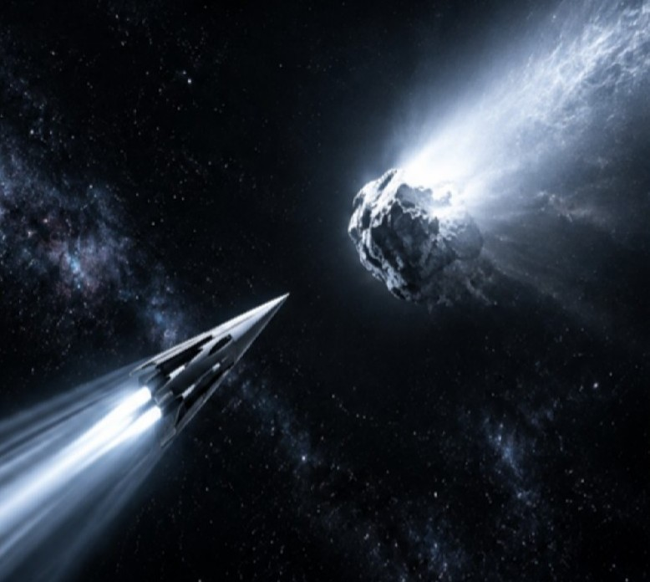
The First Mission: Interstellar Delivery
The Central Challenge
- delivering dormant biological cargo into asteroid subsurface; surviving hypervelocity impact
The Fundamental Conflict
- heat/pressure exceed biological limits; solution via solar Oberth maneuver, sacrificial multi-layer impactor, subsurface placement

Slide 11
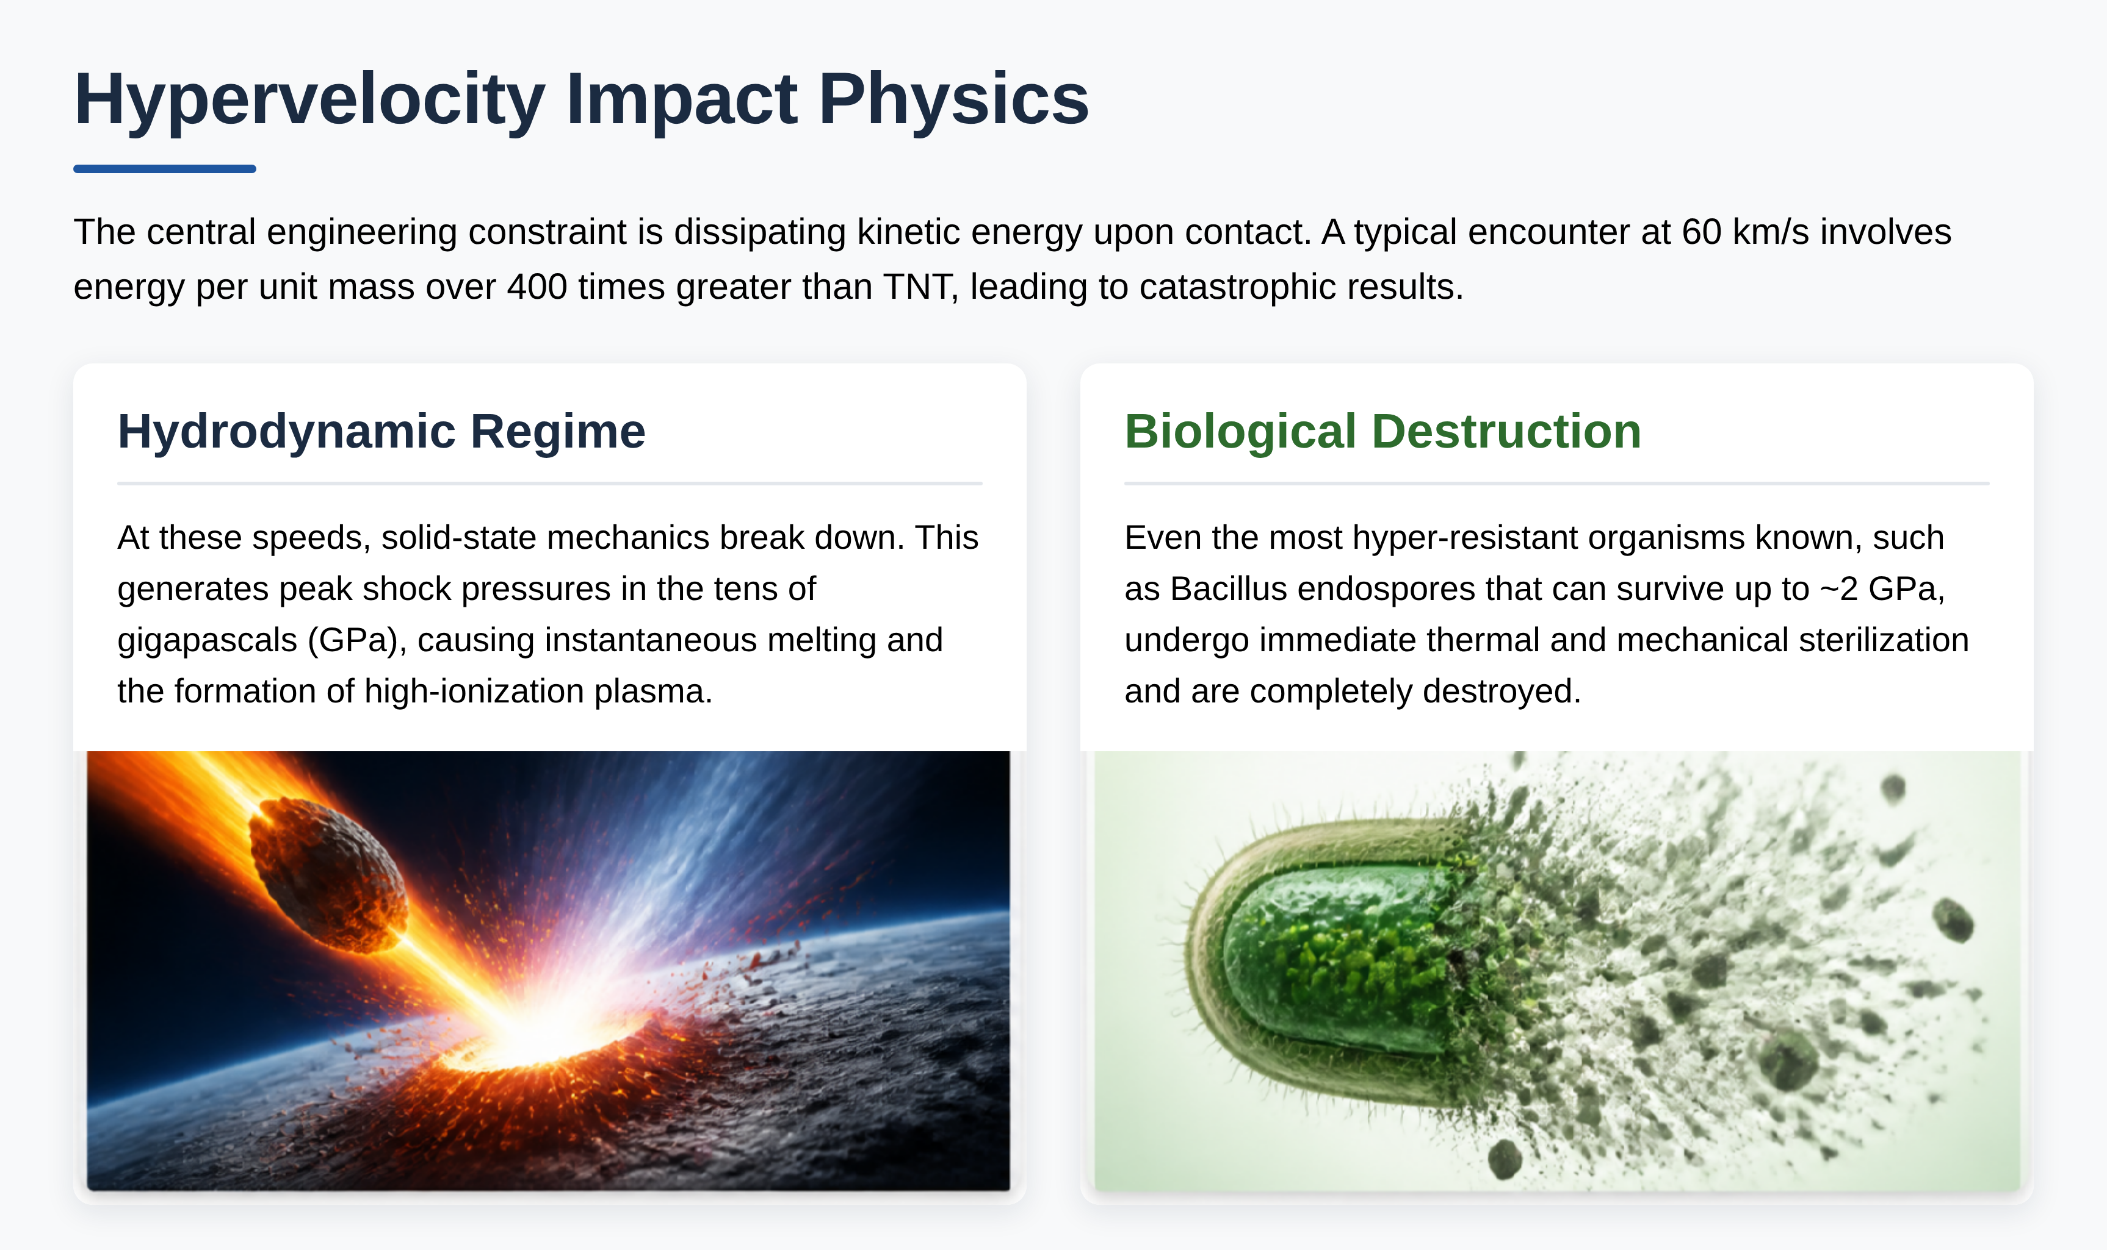

Slide 12
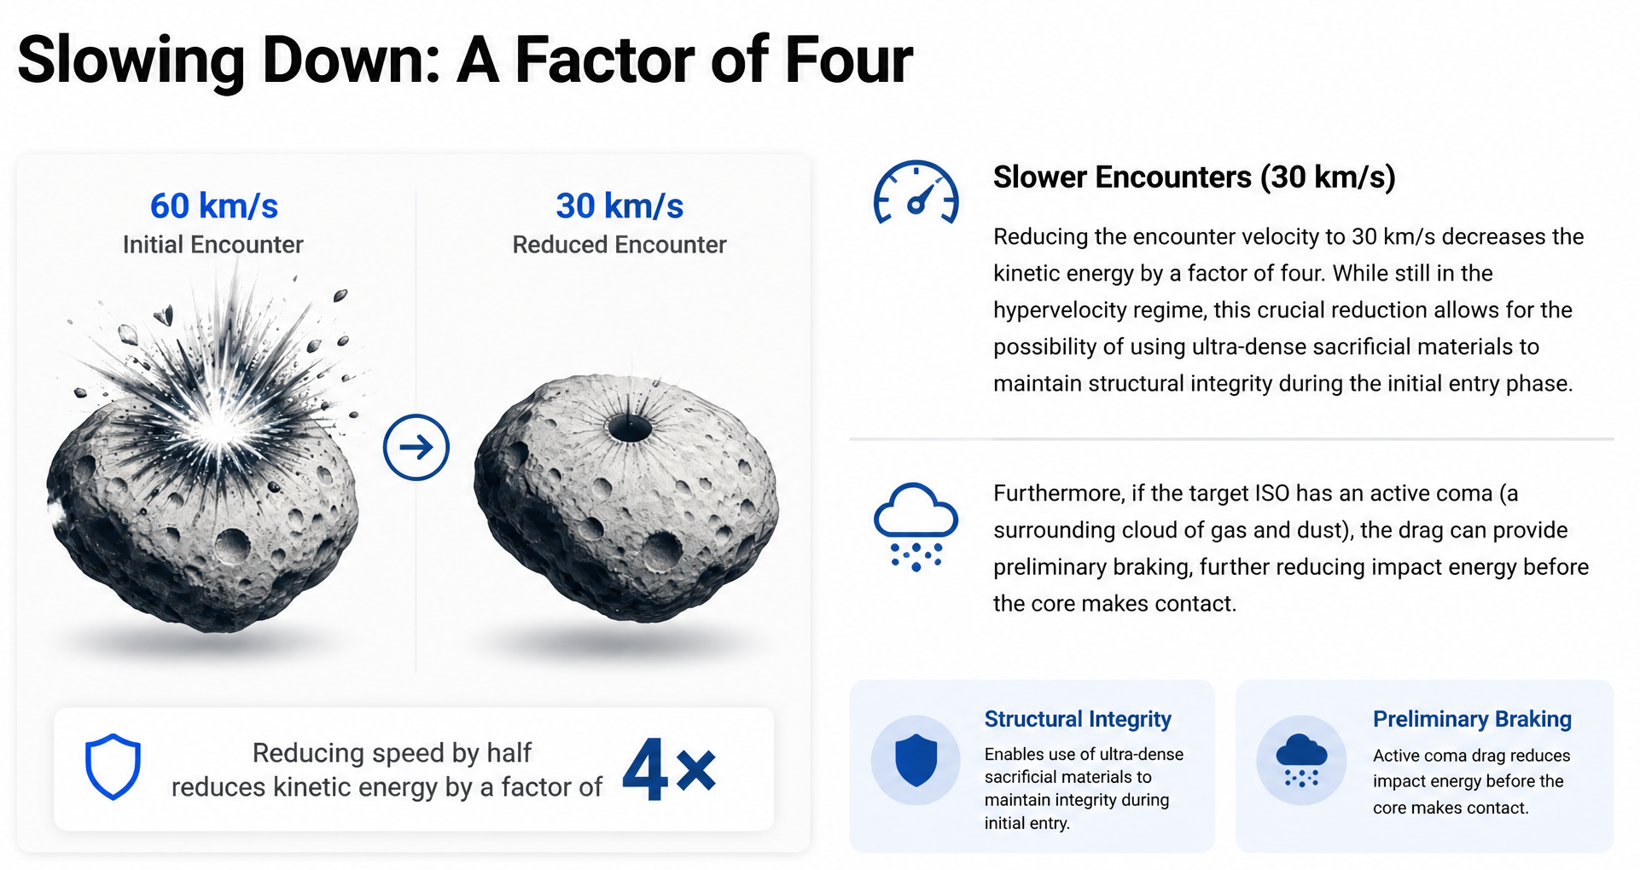

Slide 13
Detection Horizons and Target Statistics
The choice of target dictates the mission’s timeline, hardware requirements, and overall complexity. The following data is based on survey statistics from facilities like the Vera C. Rubin Observatory.
3 confirmed detections to date — ʻOumuamua, Borisov, 3I/ATLAS.
Vera C. Rubin survey is projected to discover several new ISOs each year.

Slide 14
 | ʻOumuamua Class | Borisov-Class | ATLAS-Class | Giant Carriers
Avg Diameter | ~100 m | ~500 m | ~1 km | ~5 km
Detection Distance | 3.0 au (Asteroid Belt) | 15.0 au (Uranus Orbit) | 30.3 au (Neptune Orbit) | 136.6 au (Kuiper Belt)
Reaction Window | 6–9 Months | 2–3 Years | Multi-year | Decades
Interception Mechanics | Requires prepositioned parking orbit (Sun-Earth L2) (20 km s⁻¹) | Enables direct Earth launch and hardware assembly (30 km s⁻¹) | Ample launch window, extr. high entry speeds (60 km s⁻¹) | Extremely rare objects, maximum preparation time.

Slide 15
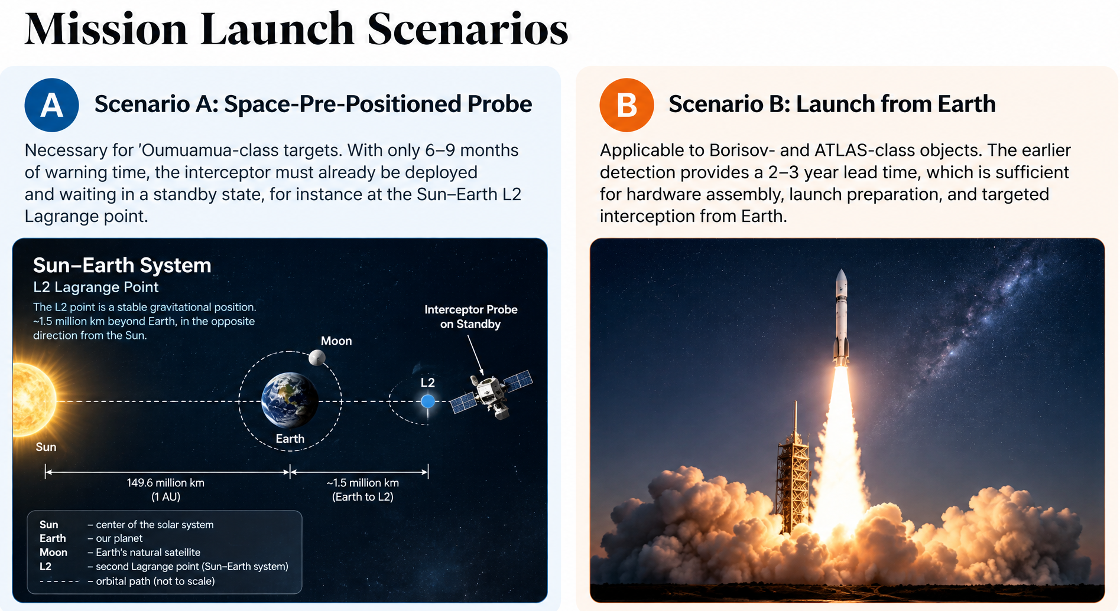

Slide 16
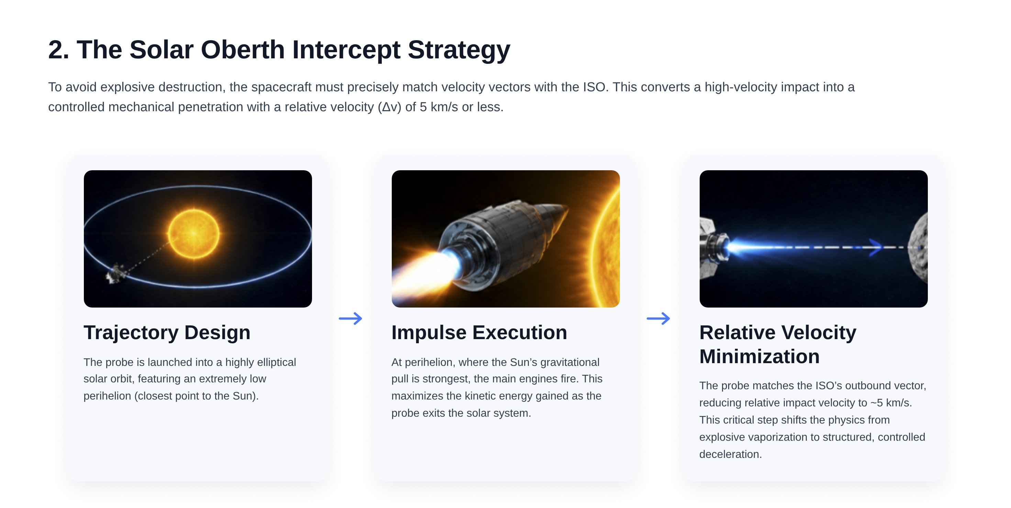

Slide 17
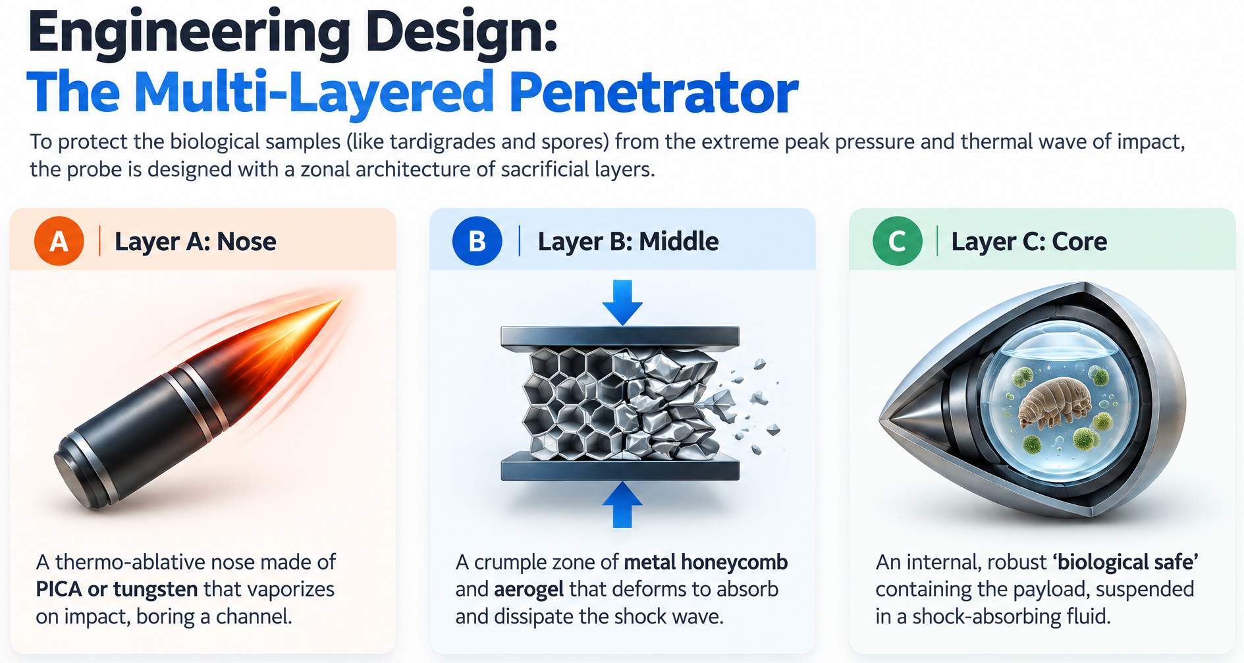

Slide 18
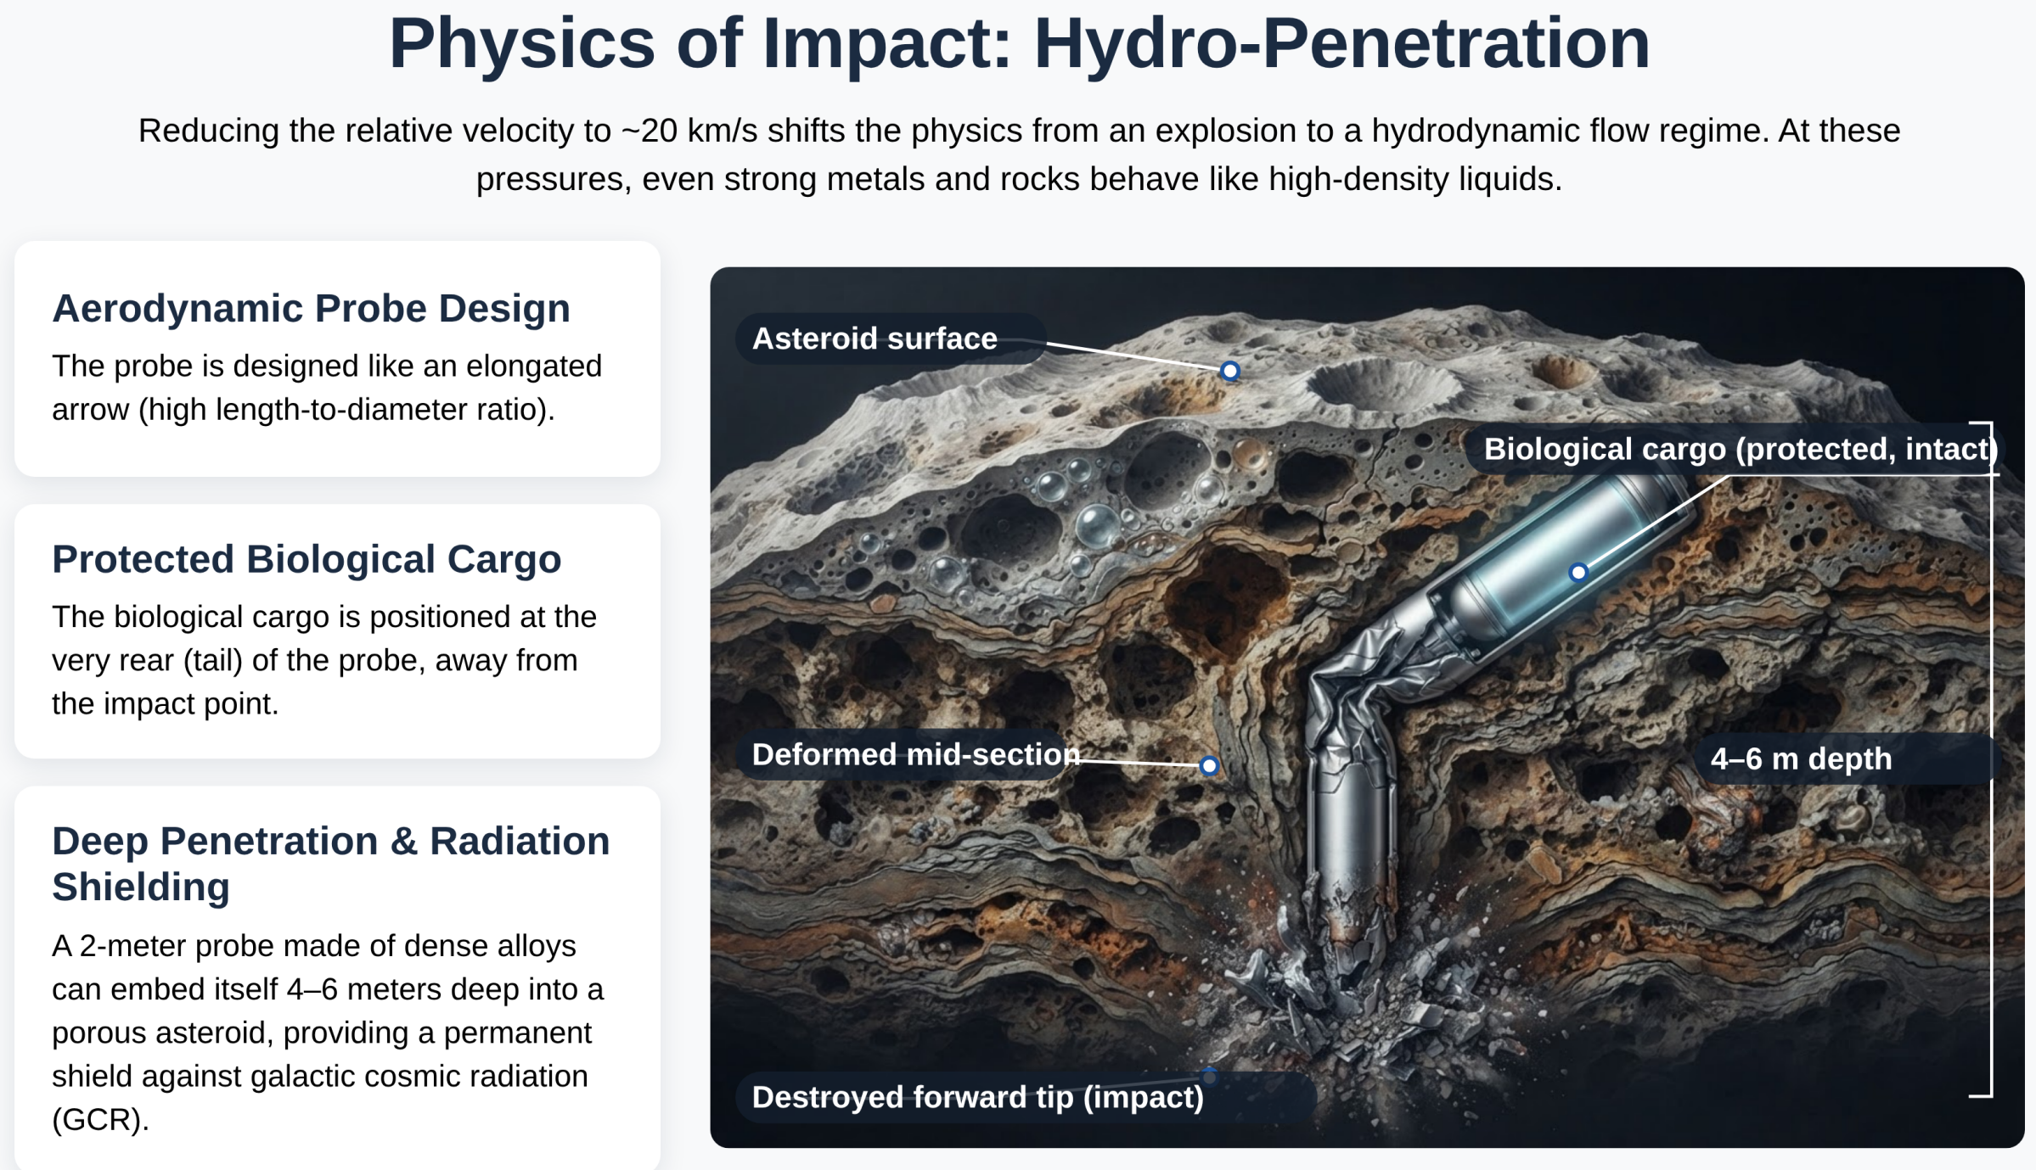

Slide 19
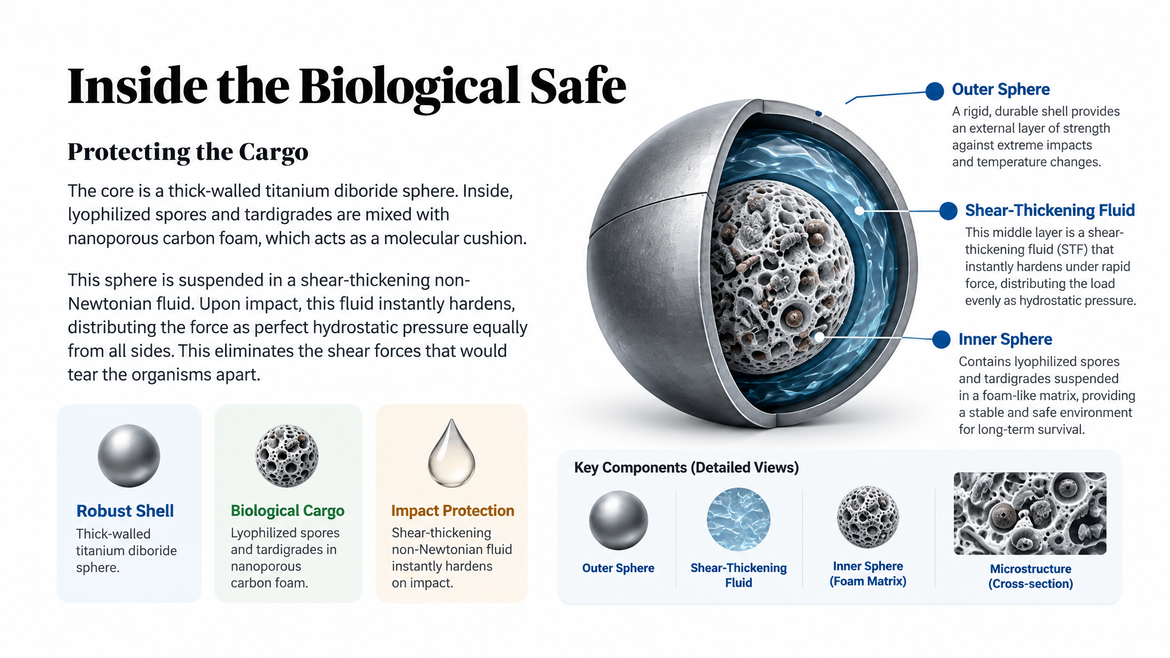

Slide 20
Optimal Multi-Layer Shielding Architecture
To maximize genomic preservation over millennia > an optimized multi-layer
vault integrates the native material of the ISO with specialized synthetic layers.
Outer Layer (2-3 m Native Regolith)
Utilizes the ISO's own natural mass to absorb the bulk of primary cosmic ray energy.
Middle Layer (20-30 cm H-BNNT / UHMWPE)
A synthetic layer with high hydrogen density to slow protons and Boron-10 to
capture secondary neutrons.
Inner Core (Synthetic Silica Encapsulation)
Dehydrated DNA is encapsulated in nanometer-thin synthetic silica spheres to eliminate chemical decay, ensuring long-term stability.

Slide 21
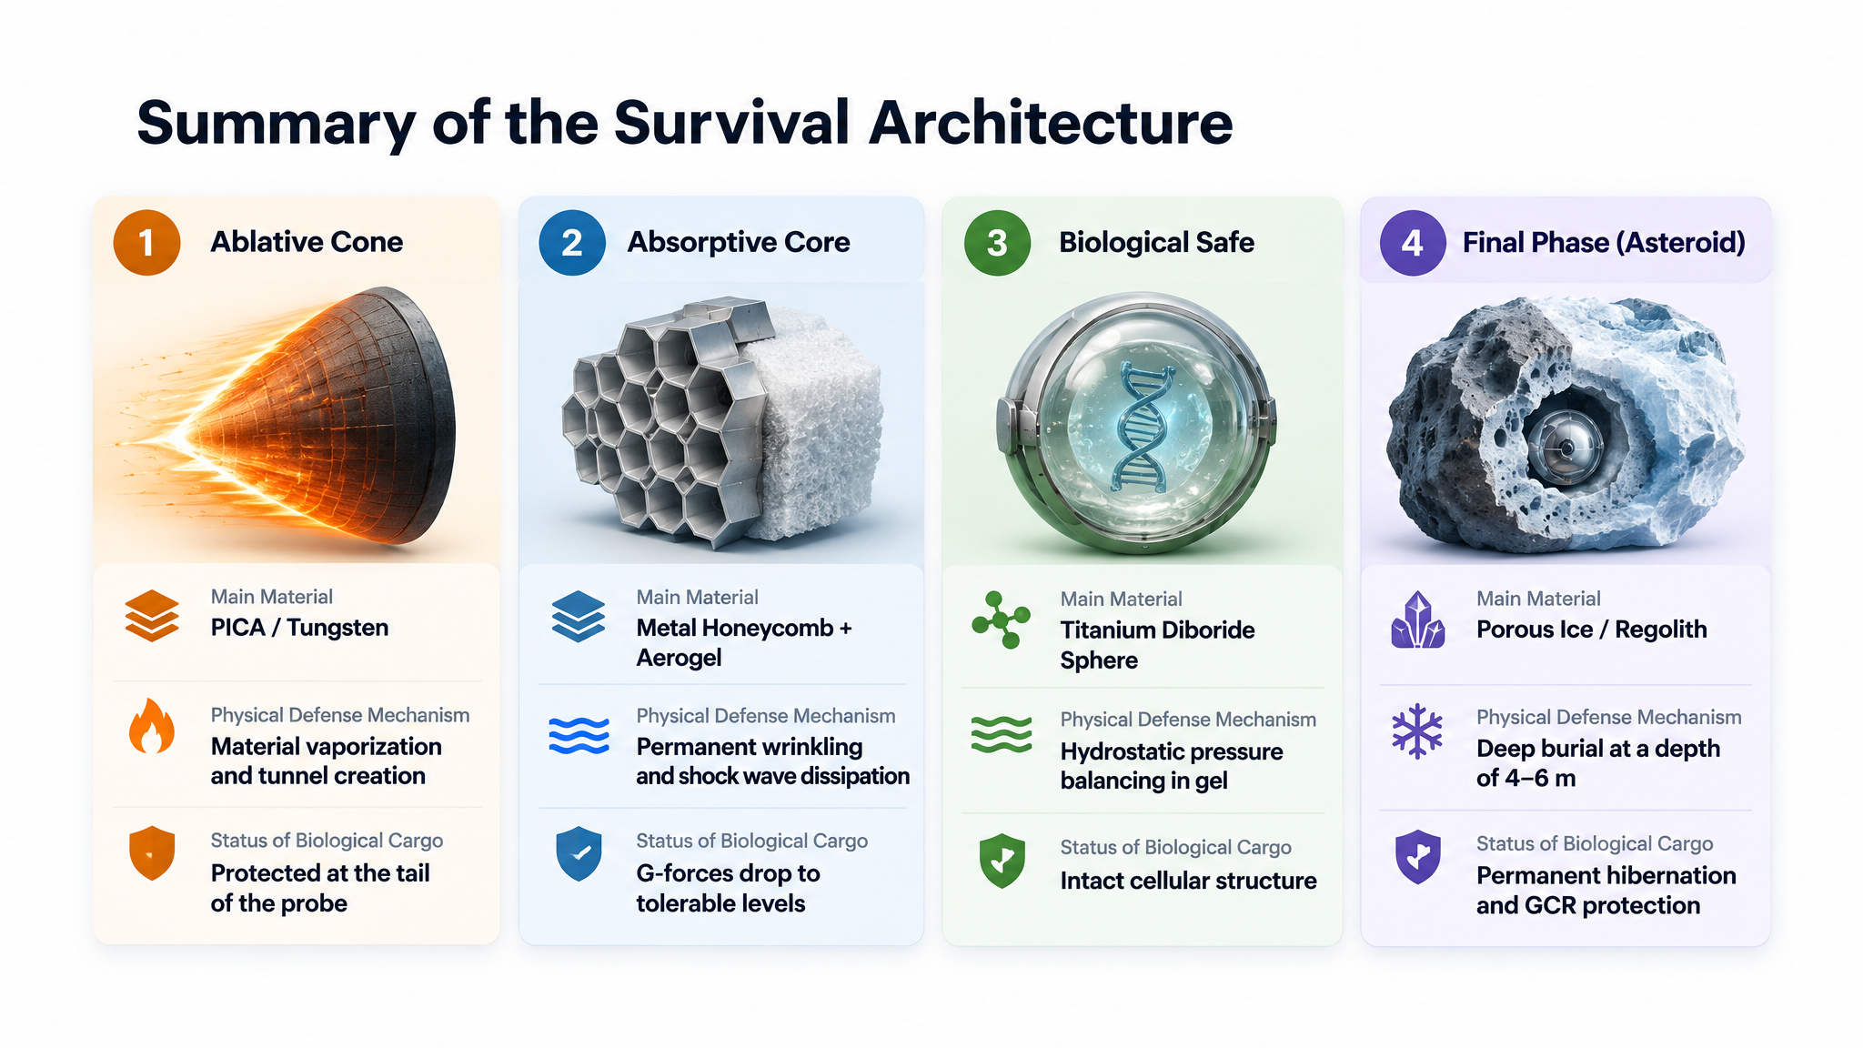

Slide 22
Economic Optimization for Spaceflight
The Challenge: Cost
Pure Boron Nitride Nanotube (BNNT) powder, an ideal
shielding material, costing $1,000–$3,500 per gram.
A solid 20 cm shield would cost millions for raw materials alone.
The Solution: Hybrid Design
A thick outer shell of inexpensive Ultra-High-Molecular-Weight Polyethylene (UHMWPE) paired with a thin 2 cm inner lining of
H-BNNT. This reduces BNNT requirements to less than 200g, bringing the cost down to a more feasible $50,000–$200,000.

Slide 23
Conclusion: A Viable Path for Directed Panspermia
A Solar Oberth maneuver enables a controlled,
low-velocity penetration (Δv ≤ 5 km/s).
A progressive, sacrificial penetrator absorbs
mechanical shock during impact.
A minimum 3-meter subsurface placement within
the ISO's silicate body shields against cosmic radiation.
This combined strategy protects the payload, providing Earth-like background dose rates over interstellar timescales.

Slide 24
Thank You!
For questions, follow-up, or collaboration, please reach out lukic@ipb.ac.rs

